Slide 1
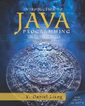
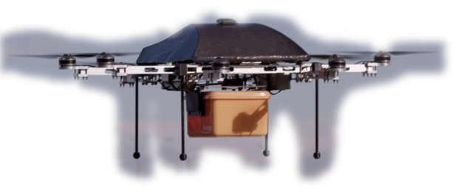
Introduction to Computer Programming II
Week 03
Exception Handling

Slide 2
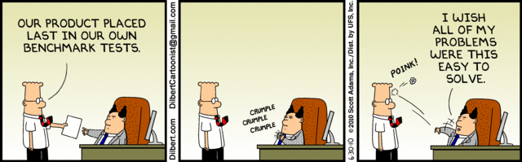
Motivation for Exceptions
Do you want to know if there’s a problem?
The sooner you find out, the better.
[1]

Slide 3
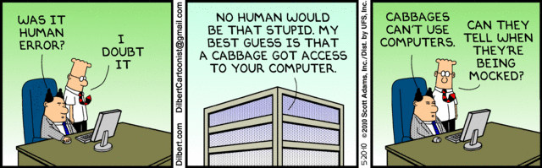
Throw/Catch
Exceptions are thrown
We wrap our code in a try/catch block

Slide 4
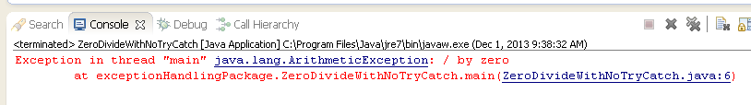
No Exception Handling: this is bad
public class ZeroDivideWithNoTryCatch {
public static void main(String[] args) {
int alpha;
alpha = 3 / 0; // force a zero-divide
}
}

Slide 5
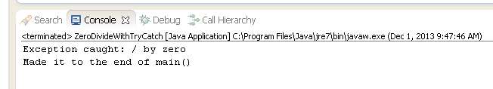
This is bad, but manageable
public class ZeroDivideWithTryCatch {
public static void main(String[] args) {
int alpha;
try {
alpha = 3 / 0; // force a zero-divide
} catch (Exception ex) {
System.out.println("Exception caught: " + ex.getLocalizedMessage());
}
System.out.println("Made it to the end of main()");
}
}

Slide 6
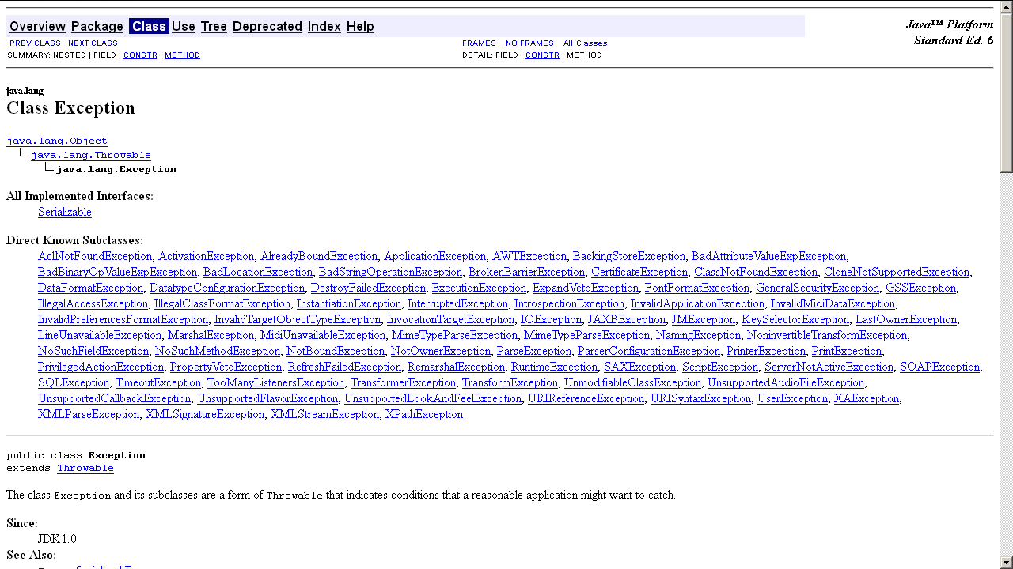
The Exception Object
Notes:
http://docs.oracle.com/javase/6/docs/api/java/lang/Exception.html

Slide 7
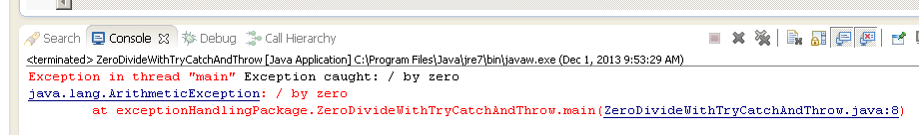
Catch and Re-throw
public class ZeroDivideWithTryCatchAndThrow {
public static void main(String[] args) {
int alpha;
try {
alpha = 3 / 0; // force a zero-divide
} catch (Exception ex) {
System.out.println("Exception caught: " + ex.getLocalizedMessage());
throw ex; // Bye Bye
}
System.out.println("Made it to the end of main()");
}
}
Notes:
Note that the code never gets to the last println statement. Be sure you can explain why.

Slide 8
The finally clause
An optional part of the try/catch control structure
The code is always executed

Slide 9
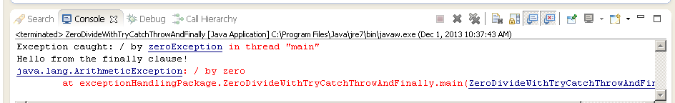
Catch and Re-throw with Finally
public class ZeroDivideWithTryCatchThrowAndFinally {
public static void main(String[] args) {
int alpha;
try {
alpha = 3 / 0; // force a zero-divide
} catch (Exception ex) {
System.out.println("Exception caught: " + ex.getLocalizedMessage());
throw ex;// Bye Bye
} finally {
System.out.println("Hello from the finally clause!");
}
System.out.println("Made it to the end of main()");
}
}
Notes:
Note that the code never gets to the last println statement but does get to the finally clause. Be sure you can explain why.

Slide 10
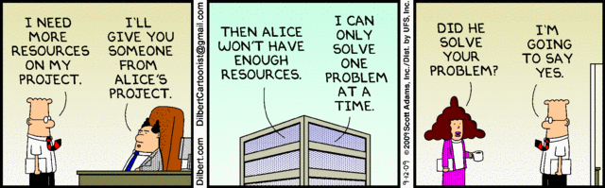
What is good exception handling?
Print a message
Log the error to persistent storage
Recover if possible
Exit gracefully
Pass the exception ‘up the chain.’
Notes:
Keep in mind that there may be no place to print a message.

Slide 11
References
[1] Dilberts courtesy of http://search.dilbert.com/

